Slide 1

College Management System
-By Web Rangers

Slide 2
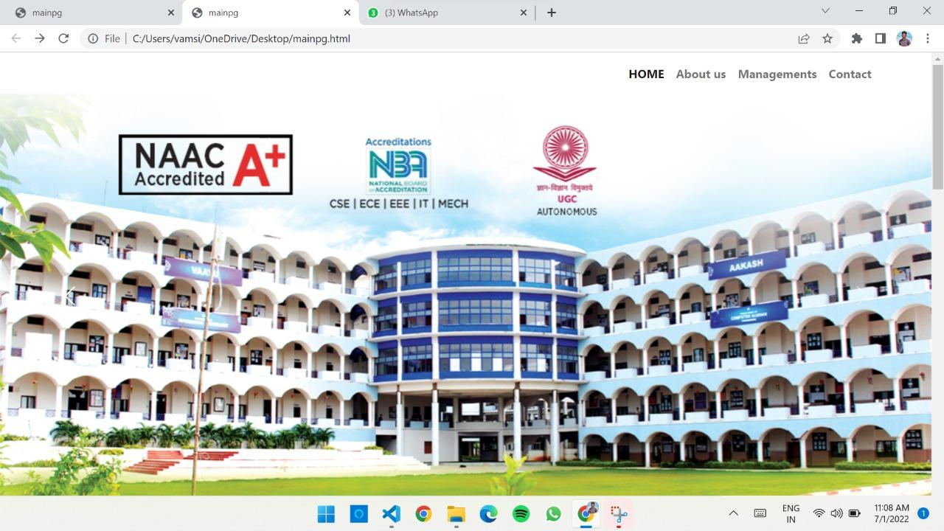

Slide 3
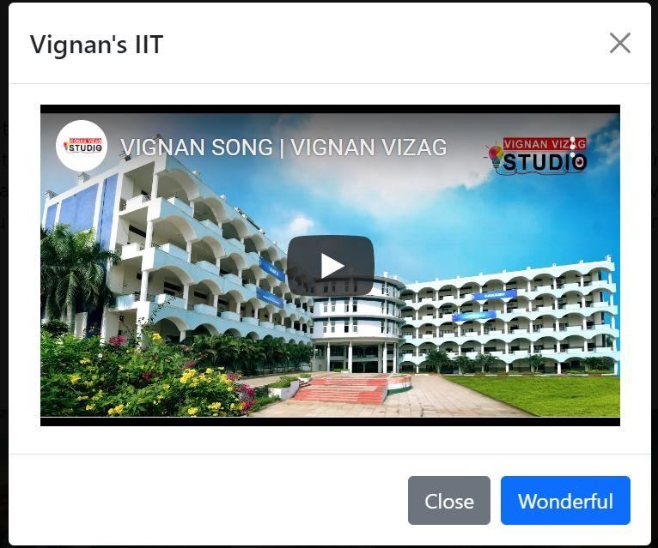
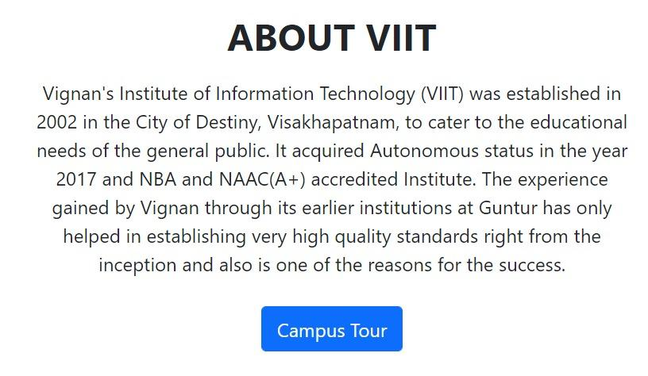
Campus Tour

Slide 4
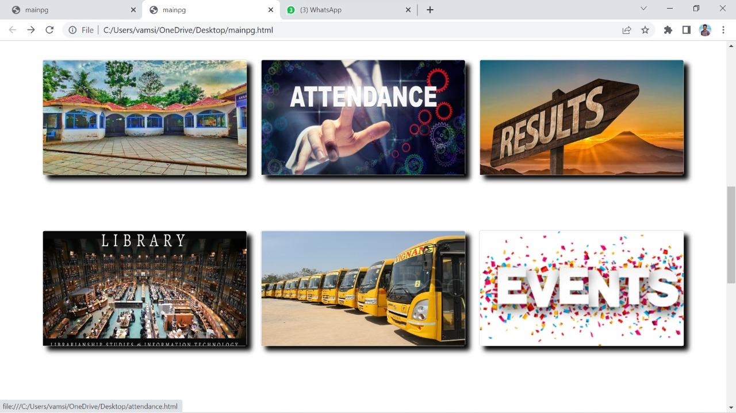

Slide 5
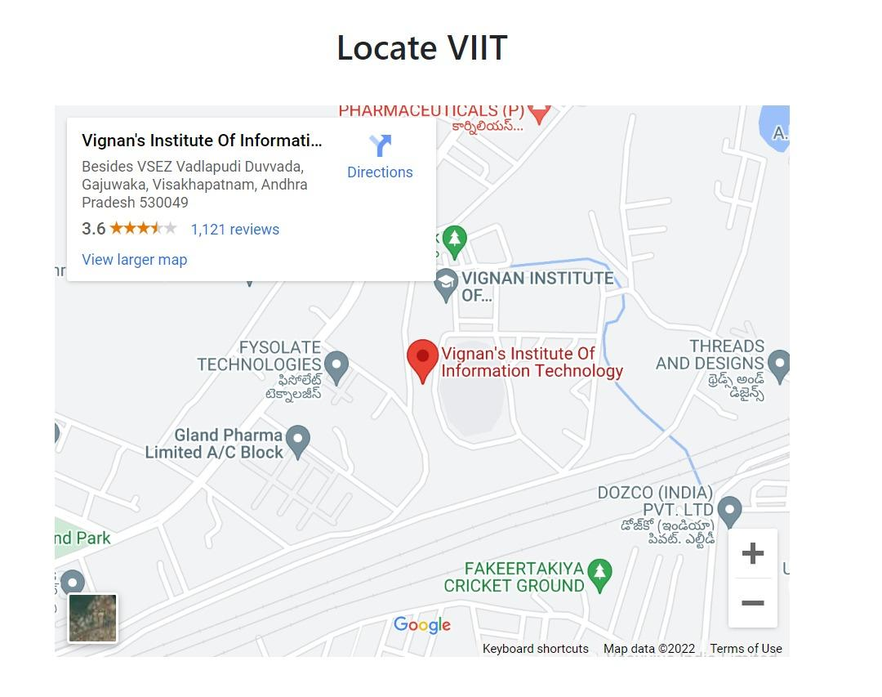


Slide 6
Conclusion
All the college activities are managed through this website via online.
Time and Manpower can be more effectively utilised and information can be easily available to the user as it made online.
Different activities are divided into different modules and presented in a single window which will be in a completely user friendly manner.

